Slide 1
Benardete’s Grim Reaper Paradox and the Necessary Finitude of Time
Rob Koons, Univ. of Texas
koons@austin.utexas.edu
Reasons to Believe
Austin, Texas
Dec. 9, 2016

Slide 2
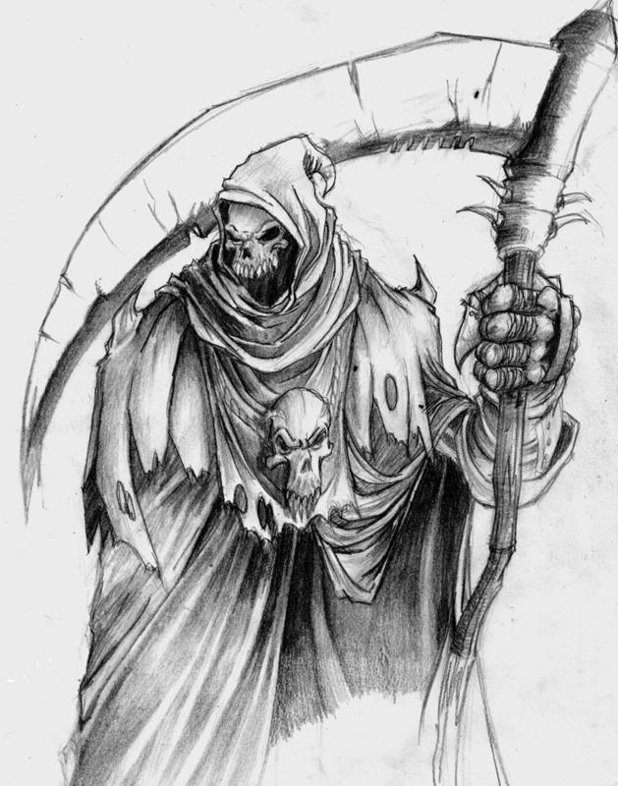
The Grim Reaper Jose Benardete’s Infinity: An Essay in Metaphysics (1964)
Death to Fred!

Slide 3
Death to Fred!
Death to Fred!
12:00:30
12:01
12:00:15
12:00:07.5
12:00:03.75
12:00:01.875

Slide 4
The Unbounded Version: Alexander Pruss (2009)
1 B.C.: GR #1
2 B.C: GR #2
3 B.C.: GR #3
etc.
Each Grim Reaper issues a death warrant for Fred if and only if no preceding GR has done so.
alexanderpruss.blogspot.com/2009/10/from-grim-reaper-paradox-to-kalaam.html

Slide 5
Proof: Some GR has acted
Assumption for reductio: no GR has acted at any time.
Consider any GR #n.
By hypothesis, no GR with number greater than n has acted.
By the definition of the GR role, if no GR with number greater than n has acted, then GR #n has issued a death warrant.
So, GR#n has acted.
Contradiction.

Slide 6
Proof: no GR has acted
From previous proof, we know that some GR has acted. Say, GR #n.
By the definition of the GR role, if GR #n has acted, then no GR #m, with m > n has acted.
So, no GR #m, with m > n has acted. (1, 2)
So, no GR #m, with m > n+1 has acted. (3)
By definition of the GR role, if no m > n+1 has acted, then GR #n+1 has acted. So, GR#n+1 has acted. (4)
But, n+1> n. Contradiction. (3, 5)

Slide 7
What do we do with paradoxes?
Contradictions cannot be true.
So, there is no possible world in which the Grim Reaper scenario is realized.
Nonetheless, the possibility of the Grim Reaper scenario follows from some quite plausible assumptions (including the assumption that an infinite past is possible).
The paradox demonstrates that at least one of these assumptions must be false.

Slide 8
What might lead us to think (initially) that the GR story is possible?
Assume that a simple, one-step GR scenario is possible.
Assume that an infinite past (either bounded or unbounded) is possible.
Assume an appropriate version of David Lewis’s Patchwork Principle.
Assume that powers and dispositions are intrinsic to things at times.
From these four assumptions, the possibility of the infinitary GR stories follows. So, one of them must be false.

Slide 9
Responding to Paradoxes
When we find an inconsistent set of very plausible principles, we must decide which is the weakest link and reject it.
In this case, the weakest link is the possible infinity of the past.
We have no verified examples of such a thing.
Its very possibility has often been challenged in the history of philosophy. E.g., the kalaam philosophers.

Slide 10
The Inconsistent Set
Proposition 1: Possible Grim Reaper. It is possible that there exist a Grim Reaper and an interval of time t such that the GR has the power and disposition to issue a warrant that persists until the end of t if and only if no warrant existed at the beginning of t.

Slide 11
Proposition 2: A Patchwork Principle
David K. Lewis, “Postscripts to ‘Survival and Identity,’” in Philosophical Papers, Volume 1 (Oxford University Press, 1983).
“Here I rely on a patchwork principle for possibility: if it is possible that X happen intrinsically in a spatiotemporal region, and if it is likewise possible that Y happen in a region, then also it is possible that both X and Y happen in two distinct but adjacent regions. There are no necessary incompatibilities between distinct existences. Anything can follow anything.”

Slide 12
The Patchwork Idea
Start with some possible patches: an event, situation or scenario, wholly contained within some region of space and time. The specified qualities must be intrinsic to some things in the region at the relevant times.
Add a possible spatio-temporal arrangement: a set of non-overlapping regions, each large enough to contain one of the scenarios.

Slide 13
The Patchwork Idea
Result: a “quilt”. A possible world in which the possible scenarios co-exist, standing in the possible arrangement in space and time.
Why? Any set of intrinsically specified possibilities are “compossible” (possibly realized together), so long as we can find enough “room” for all of them.
The patchwork model is crucial for our knowledge of what is possible, since we cannot directly perceive what is merely possible.

Slide 14
Infinitary Patchwork Principle
Proposition 2: Infinitary Patchwork. If there is a possible world W₁ containing some (intrinsically-specified) scenario S within interval t, and there is a possible world W₂ containing infinitely many non-overlapping intervals similar to t, then there is a possible world W₃ containing an isomorphic copy of the infinite series in W₂, in which every interval of the series contains a duplicate of scenario S.

Slide 15
Proposition 3: Intrinsicality of Powers
The Grim Reaper scenario (as described in Proposition 1) is intrinsic to the Grim Reaper during the interval t.
The Grim Reaper scenario is described in terms of the Grim Reaper’s powers and dispositions to act, not in terms of what the Grim Reaper actually does.
These include: passive powers (a disposition to receive information from his predecessor), active powers (the power to send information to his successor), and dispositions (the propensity to generate or transmit information according to a certain rule).

Slide 16
Proposition 4: Possible Infinity of the Past
It is possible for there to exist an infinite series of contiguous and non-overlapping intervals, each one earlier than the last.
The series has a last member (in time), but no earliest member.
The intervals have to be contiguous or abutting, so there is no worry about action at a temporal or spatial distance.
If we accept all four principles, the possibility of the Grim Reaper follows logically.

Slide 17
The Weakest Link
One of the four propositions must be false.
We have least reason to accept Proposition 4, the possible infinity of the past.
We have no direct experience of an infinite past, nor is one required by our best scientific theories. The Big Bang.
Infinite past seems problematic: John Philoponous and the Kalaam tradition (al-Ghazzali).

Slide 18
Objections to the Intrinsicality of the Reaper Scenario
If the Grim Reaper scenario is not intrinsic to the Reaper during the period in question, then we cannot apply the Patchwork Principle to it.
For example: it is possible for Smith to be the tallest person, and it is possible for Jones to be the tallest person, but it is not possible for both Smith and Jones to be the tallest.
Being the tallest person is not intrinsic to Smith or Jones.

Slide 19
Is the GR rule intrinsic to the Reaper?
Each Reaper is supposed to ‘act’ just in case no previous Reaper has acted. This doesn’t sound intrinsic to the Reaper in question.
However, suppose that the Reapers are arranged in space and time in such a way that each is contiguous to its predecessor at the beginning of its interval, and with its successor at the end.
Suppose that each Reaper has its own unique ‘signature’.

Slide 20
The Signaling Story
Given these assumptions, here is the Signaling version of the Grim Reaper scenario:
Each Reaper #n may receive a signal from his predecessor. The signal either says “No warrant” or “GR #m has issued a warrant” (for some m > n).
If the Reaper #n receives the second signal at the designated time, he transmits it to his successor.
If the Reaper #n does not receive the second signal at the designated time, he sends the signal “GR #n has issued a warrant”.

Slide 21
Powers and Dispositions
The Signaling story attributes to each Grim Reaper a set of powers and dispositions:
The “passive power” or disposition to be affected by its predecessor, receiving and interpreting correctly any signal sent by it.
The “active power” to transmit a signal to its successor.
The disposition to exercise this active power according to the specified rule.

Slide 22
Intrinsicality of Dispositions
The success of the GR paradox as a refutation of the possibility of an infinite past turns on the issue: are powers and dispositions intrinsic to the things that have them, when they have them?
The answer seems to be Yes. Otherwise, how could powers and dispositions explain events?

Slide 23
Metaphysical Accounts of Powers
There are three accounts of powers:
Powers are intrinsic properties of things, irreducible to non-powers. (Power primitivism)
The powers of a thing are reducible to its pure qualities and the laws of nature. (Nomic account)
The powers of a thing are reducible to its pure qualities and the total history of the world (in respect of its pattern of regular succession). (Neo-Humean account)

Slide 24
Primitivism and the Nomic Account
If Primitivism is true, then powers are intrinsic, and the Patchwork principle applies to the GR paradox.
If the Nomic account were true, then we could appeal to a modified Patchwork principle. Although the GR scenarios now overlap (they each “contain” their worlds’ laws of nature), they are in perfect agreement throughout the overlap “zone”. Exactly the same laws can hold throughout the infinitary story.

Slide 25
The Neo-Humean Way Out
Only the Neo-Humean has good reason to reject the applicability of the Patchwork Principle to the GR story.
As we know, we cannot tell a consistent story of the total history of the world containing an infinite regress of Grim Reapers.
However, the Neo-Humean gets the order of explanation backward: he thinks that the course of events explains the possession of powers, not the other way around.

Slide 26
Other objections?
Some dispositions are not intrinsic. True, but irrelevant.
Dispositions and powers can fail.
True, but we can define the scenario to include each GR’s successfully acting in character. Success or failure in exercising one’s dispositions is intrinsic.
Reject infinitary patchwork?
Ad hoc. It is supported by exactly the same considerations that support the binary version.

Slide 27
A Second “Prussian” Paradox
Assume that there is a possible world with an infinite past – as the framework for the Patchwork Principle.
Now, assume that the following zero-sum game is possible: two players, Guesser and Placer.
Guesser guesses Heads or Tails, and then Placer puts down a penny, either Heads or Tails up. Placer always does the opposite of what Guesser has guessed. (So, Placer is guaranteed to win every round.)

Slide 28
Second Stage
However, Guesser plays according to the following strategy:
If Placer has played Tails in almost all past rounds (all but a finite number of rounds), then guess “Tails”.
Otherwise, guess “Heads”.
Call this the Magic Strategy.
This strategy depends only on what Placer has done in the past, not on what he will do in this round (so no spooky circularity of causation).

Slide 29
The Magic Strategy is Magical
The Magic Strategy is guaranteed to win infinitely often.
Suppose that Placer does not play “Tails” infinitely often. Then he must play “Heads” almost always. In this case, the Guesser has guessed “Heads” every time, and so has almost always won.
Suppose Placer does play “Tails” infinitely often. Then the Guesser has guessed “Tails” always, and so has won infinitely often.

Slide 30
Contradiction!
But this is impossible, since we already proved (by a very simple argument) that Placer must win every time!
Since it’s a zero-sum game, it’s impossible for Guesser to win (a) never and (b) an infinite number of times!
Once again, the weak link is in the assumption of a possibly infinity of past time.

Slide 31
Must Time have a Beginning?
We must distinguish two hypotheses:
H1. Possible Infinite Past, with Infinitely Many Parts (PIPIP). There is a possible world W and a region R and time t of W such R has a temporal part wholly earlier than d units before t, for every finite interval d.
H2. Possible Quantitatively Infinite Past (PQIP). There is a possible world W, and a region R and time t of W such that R is wholly earlier than t, and R has infinite duration.

Slide 32
A Simple but Infinite Past?
The Grim Reaper paradox is a reduction of H1, not H2. Hence, it doesn’t establish that it’s impossible for the past to be infinite quantitatively (in the measure of its duration), so long at some point in the past we reach an infinitely long period without temporal parts.
H3. No Simple Infinite Past. No spacetime region can have an infinite duration without having infinitely many proper parts or temporally overlapping an infinite number of temporally finite and temporally disjoint regions.

Slide 33
A Dilemma
Either time has an intrinsic measure (such that empty time with determinate duration is possible) or not.
If time has an intrinsic measure, then any period with infinite length has infinitely many temporal parts (implying H3).
If time has no intrinsic measure, then it must derive its measure from the natural measure of some process or processes that it contains.

Slide 34
Second Horn
A simple infinite past period can contain no processes that end within it. So, it must contain only beginningless processes, none of which end before it ends.
Second dilemma: either one of these processes contains an intrinsic measure, or none do.
If none do, then the simple past cannot have an infinite measure.

Slide 35
Second Horn of the Second Horn
If one of the beginningless processes has its own intrinsic measure, marking out an infinite number of non-overlapping segments of time, then the initial temporal period must have temporal parts corresponding to these segments.
Conclusion: no simple period can have infinite duration.

Slide 36
From Beginning to God
Kalaam Causal Principle (KCP): every entity that has a beginning in time has a cause. (Craig 1979)
Time itself has a beginning in time.
So, time itself has a cause.
Problem: this presupposes temporal or spacetime substantivalism.

Slide 37
The Cause of the Universe
Let the ‘universe’ refer to everything that is wholly located temporally.
Since time has a beginning, it follows that the universe had a beginning in time, and so a cause.
Problem: this assumes mereological universalism.

Slide 38
A Plural Kalaam Principle
Plural Kalaam Causal Principle (PKCP): any entities that jointly have a common beginning in time have some things that cause them (and the latter things are not among the former things).
The universe consists of some things that jointly have a beginning in time, so there must be some things outside the universe that cause them.
Problem: if time exists, is it possible for anything to exist outside of time? Won’t everything have a beginning in time, including God?

Slide 39
A Scotistic Twist
Scotistic Kalaam Causal Principle. Any thing or things that begin to exist and that could possibly be caused to exist are in fact caused to exist.
This would give us uncausable first causes of all the causable things in the world.

Slide 40
Two Final Problems
Problem 1: The Kalaam Causal principles are in conflict with the Patchwork principles.
Given Patchwork, we could construct a world in which events occur without being preceded by appropriate causes.

Slide 41
Three Possible Solutions
The Kalaam principles are not metaphysically necessary. They hold in the actual world and all nearby worlds.
Add a causal proviso to the Patchwork principles. The revised Patchwork would still apply to the GR scenario, since no causal principle is violated.
The constructed worlds are really possible, after all, since God exists in every possible world and can timelessly and directly cause each event (by a miracle, if necessary).

Slide 42
One Last Problem
Given relativity, there is a loophole to the Kalam argument.
We can deduce that every event has a finite past. Let’s assume that that means (in relativistic terms) that every event has a finite past time cone.
However, it is consistent with that hypothesis that the universe as a whole has an infinite past, with different regions having different lengths of history, with no upper bound.

Slide 43
Multiple Big Bangs
However, such a relativistic model would be one in which there were many big bang events (rather than just one), “mini big bangs,” each with no temporally prior period (within the bang’s backward time cone), and so no cause within time.
Thus, we would still need God as the timeless cause of each of the local Big Bang events.

